Slide 1
Rectangles, Ellipses, and Layering
Mack 2021

Slide 2
Overview
In this learning activity students will create a visual composition using the p5 shape-drawing functions rect() and ellipse(). They will continue to build on their understanding of functions and their parameters to recreate the robot from lesson 1.

Slide 3
Objectives
Students will be able to:
Consult the p5 reference
Create rectangles using the rect() function
Create ellipses using the ellipse() function
Understand the concept of layering to create images using multiple shape functions

Slide 4
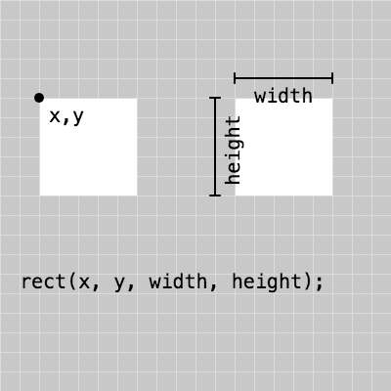
Draw A Rectangle
p5 has many built-in functions to draw different shapes. In this example, we are drawing a rectangle.
The rect function takes four parameters: x, y, width and height. The x and y values refer to location on the canvas and the width and height refer to size.

Slide 5

Draw A Rectangle
Recreate the following example and play with the parameter values.

Slide 6
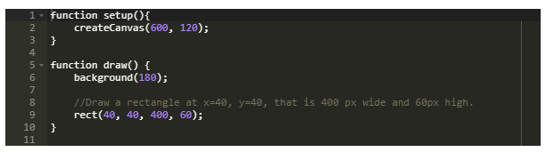
Draw A Rectangle
Example

Slide 7
Draw A Rectangle
To help you place shapes where you want them on the canvas, you can add the following line to your code:
text(mouseX + ", " + mouseY, 20, 20)
Try it out! You can move your mouse to where you would like your shape to be, and write down the coordinates to use them as parameters in your function call.

Slide 8
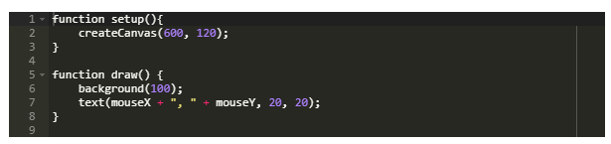
Draw A Rectangle
You also use this blank grid template to help you position your shapes.

Slide 9
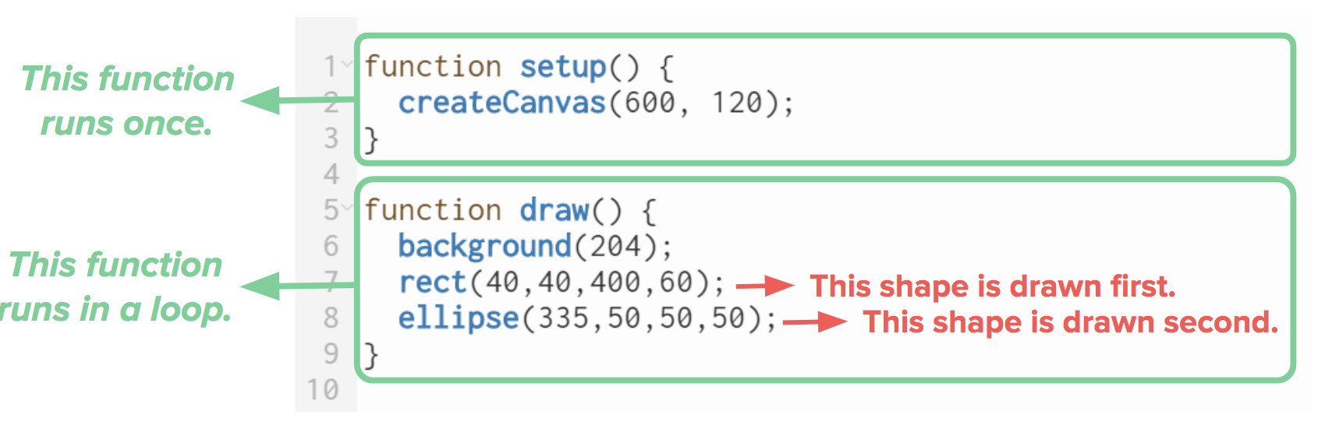
Drawing Order
In p5, shape and color functions are rendered to the canvas in the order they're written in the program - from top to bottom.

Slide 10
Drawing Order
Play with the order of the shapes here. Then remove the comments to see how the rectangles layer on one another.
http://alpha.editor.p5js.org/cs4all/sketches/S1aG4fO7m

Slide 11
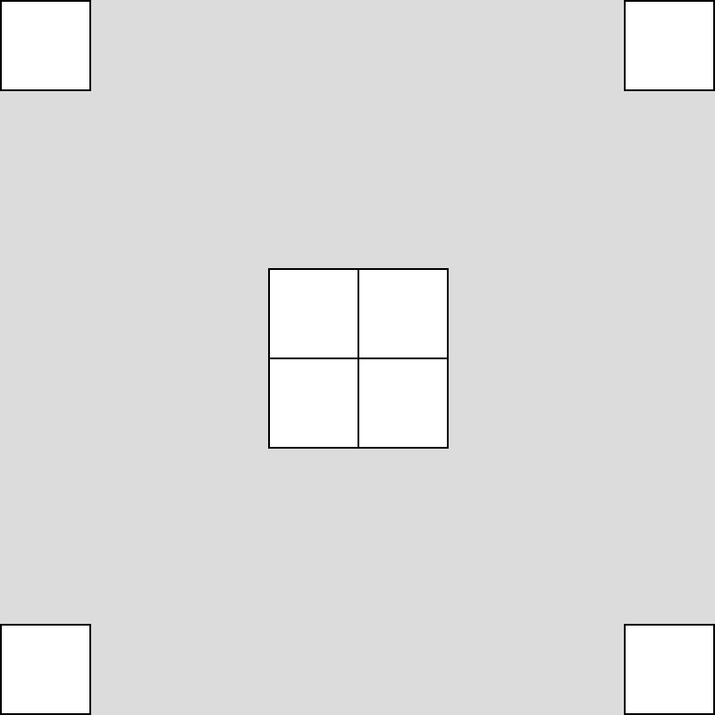
Practice
Recreate the following sketch using rectangles
Drawing Rectangles

Slide 12
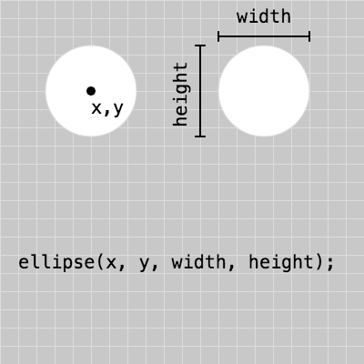
Draw an Ellipse
Now draw an ellipse. Its parameters are the same as for the rectangle.
The ellipse function takes four parameters: x, y, width and height. The x and y values refer to location on the canvas and the width and height refer to size.

Slide 13

Draw an Ellipse
Recreate or access this example and play with the parameter values.
Your ellipse might overlap with your rectangle, like in the example below. Because the code in your sketch is executed from the top down, one line at a time, the shape that was drawn last will always be on top of the rest.

Slide 14
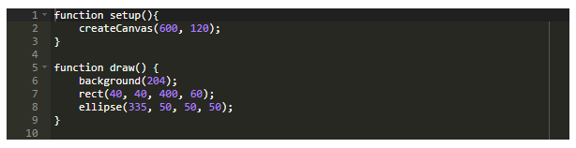
Draw an Ellipse
To change the drawing order, simply cut the line ellipse(335, 50, 50, 50); and paste it before the line rect(40, 40, 400, 60);

Slide 15

Practice
Recreate the following image using rectangles and ellipses:
Some calculations will be needed in order to get the ellipse in the corner. You should duplicate your previous sketch so that they don't have to code one from scratch and keep a copy of their original sketch.
Draw an Ellipse

Slide 16
Practice
Using code, draw the robot that you made on graph paper. You can use this starter sketch that contains the following:
Mouse canvas position indicator (x, y)
Adaptable grid
Think about the different components that make up your robot and what order will you need to draw its shapes. List them on paper before you start coding.
Draw Your Robot

Slide 17
Extensions
Check out the p5.js reference online and add more shapes to your robot. Can you figure out how to add a triangle? A polygon?
Try this out!

